Slide 1
ENGLISH POETRY: LITERARY AND INTELLECTUAL BACKGROUND
Dr. P. Muralidhar Sharma
Assistant Professor
School of English
Gangadhar Meher University
Sambalpur, Odisha

Slide 2
Old English Poetry
Oral verse narratives of the Angles, Saxons, and the Jutes
Caedmon: late 7th century
Cynewulf: 9th century
Verses inspired from scripture
Predominantly Christian themes
“Hymn of Creation”: only surviving poem
Repository of commonly used poetic expressions
Kennings: compounds replacing common nouns, i.e. “whale-path” or “swan-road” for sea or “God’s-beacon” for Sun, and “ring-giver” for king

Slide 3
Manuscripts of Old English Verse
Manuscripts dating back to 10th and 11th centuries
Beowulf Manuscript: Beowulf, Judith, etc
Exeter Book: Riddles, religious and didactic verse
Junius Manuscript: Biblical verse
Vercelli Book: Saints’ lives, short religious verses
Poems from the Anglo-Saxon Chronicle
“The Wanderer”, “The Seafarer”, “Deor”: Elegiac lamentation, spiritual subject matter
Anonymity and uncertain authorship
Debates on dates of composition

Slide 4
Beowulf

Slide 5
Scandinavian saga
Pagan, pre-Christian worldview
Anonymous authorship
Heroic poem
Series of battles between Beowulf and the monster Grendel
Defeat of Grendel by the eponymous hero
Beowulf as a warrior-hero
Epic-like in scope: grand scenes, massive action
Disruption and restoration of order

Slide 6
Medieval English Poetry
Continuation of earlier traditions
Emergence of a literary culture that revolved around the Church
Christian, religious verse and didactic verse
Lazamon, Brut: epic conventions, traces the origin and evolution of English people, 16000 lines
The Owl and the Nightingale: 12th century, anonymous, Latin tradition of debate poetry, overheard debate between the birds from the title
Human attributes of the birds, intelligence, articulation, mutual abuse, charges and counter-charges

Slide 7
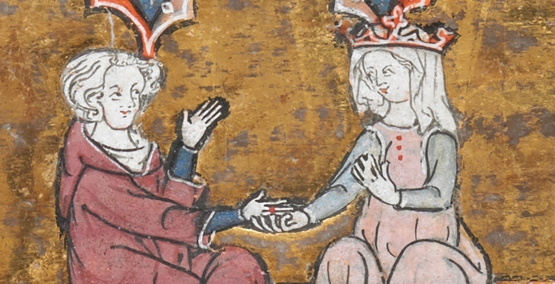
Sir Gawain and the Green Knight: 14th century, anonymous, alliterative poem, chivalric romance
Knighthood: formal rituals, code of conduct, lonely quest, King Arthur’s court as setting
Pearl, Purity, Patience
Chivalry as a poetic subject: a moral, religious and social code of Knightly and courtly conduct

Slide 8
Poetry in the Age of Chaucer
Coexistence of imitative as well as strikingly original poetry
Influence of French and Italian poetry on Chaucer
The Book of the Duchess, Roman de la Rose
Steady influence of the court on English poetry
Familiarity with the work of Roman poets like Ovid and Italian poets like Dante, Petrarch, Boccaccio
Recurrent use of the dream-vision sequence
Use of wit, irony, and humour
The Parliament of Fowls, Troilus and Criseyde

Slide 9
The Canterbury Tales: magnum opus
Significant early poetic work in the vernacular
Less imitative, more original poetic conventions
Pilgrimage as the major motif
Exchange of tales (24 in total), wily banter, humour
A lively tableaux of 14th century English social arrangement
Rank, hierarchical order
Knight, Squire, Prioress, Monk, Merchant, Man of Law, Franklin, Miller, Reeve Pardoner, Wife of Bath
Witty repartee, lively conversation, jovial company of pilgrims

Slide 10
Coexistence of the sacred and secular elements
Use of varied generic conventions
Courtly romance, chivalric tale, saints’ lives, beast fable, allegory
Colloquial language
Cataloguing of characters
Moral concerns in Chaucer’s poetry
Social satire
Detailing of individual character traits
William Langland: Piers Plowman: Allegorical
John Gower: Confessio Amantis, Vox Clamantis

